Slide 1
Automated Testing for Websites using Selenium IDE
robert@robertgreiner.com

Slide 2
Table of Contents
What is Automated Testing?
Why Should I Use Automated Testing?
Getting Started With Selenium IDE

Slide 3
What is Automated Testing?
Automated tests perform repeatable actions on your application and compare expected values with actual results.
“Drive” the application the same way a user would
Create scripts/applications to repeat tests in the future
Improves documentation around existing functionality
Run while you are sleeping

Slide 4
Why Should I Use Automated Testing?
Reduces human errors
Exposes defects to development team faster
Faster than human testers
Cheaper to run and maintain
Continues to work when your application changes
Protects against regression defects
Improves communication between groups

Slide 5
Getting Started With Selenium IDE
Selenium IDE is a Firefox extension that allows you to record, edit, and debug functional tests against your web application.
Record and playback tests
Save and export test cases
Compare expected values with actual values

Slide 6
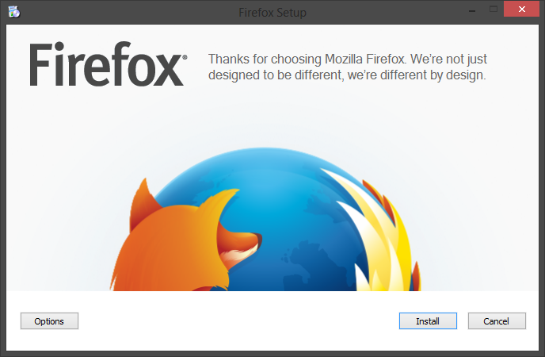
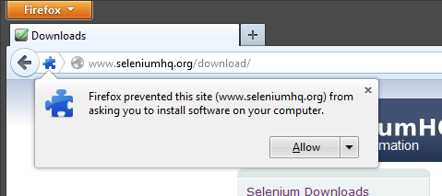
Installing Selenium IDE
Download an install Firefox
http://www.mozilla.org/en-US/firefox/new/
Install Selenium IDE Firefox extension
Open Firefox
http://www.seleniumhq.org/download/
Click “Download latest released version 2.x.x”
Install Selenium and dependencies

Slide 7
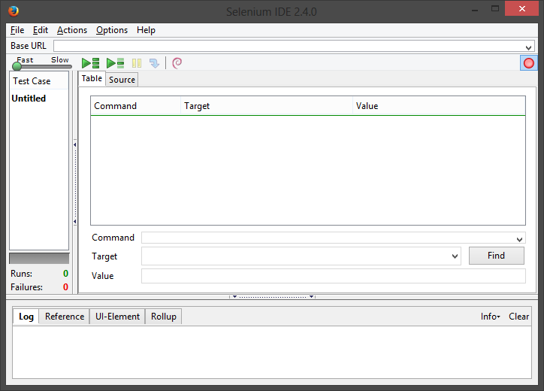

Running Selenium IDE
Open Firefox -> ctrl+alt+S
Just start browsing, recording starts by default!

Slide 8
Demo: Testing a Website
Arrange
Act
Assert
Verify results
Perform desired behavior
Setup initial state

Slide 9
Questions?
Robert Greiner
robert@robertgreiner.com
@robert_greiner

